Slide 1
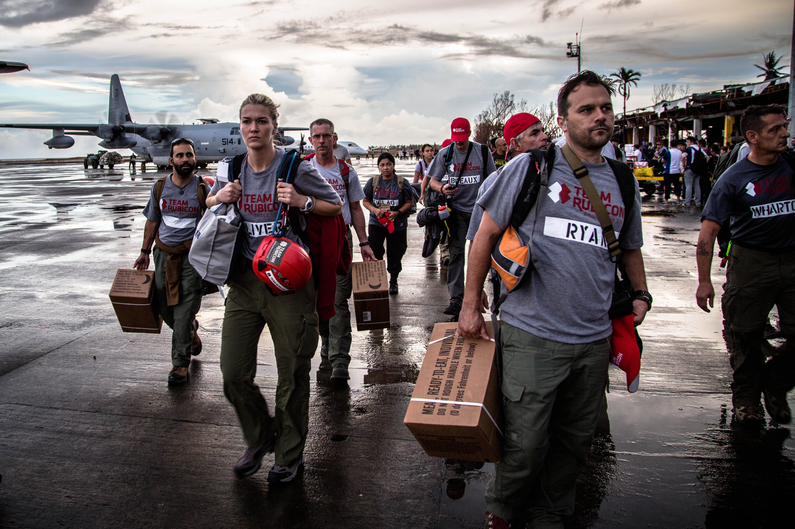


元気
Team 6
Create a web application that improves the efficiency of registering and tracking spontaneous volunteers by management during each disaster
Code for Good 2017 – Team 6

Slide 2
Our Mission Statement
“Create a web application that improves the efficiency of registering and tracking spontaneous volunteers by management during an individual disaster”

Slide 3
Our Task
Better user experience:
Reduce processes
More mobile use
Mobile use:
Faster and easier to sign up
Web application
Scalability:
System that can work for many during one day
Security:
Safely store volunteer information
Allow not necessary information to be hidden
Unique identity:
Uniquely identify each spolunteer more accurately then their a number
Location track:
Be able to quickly view availability of spolunteers and their location
3. Scalability
4. Security
5. Unique identity for each volunteer
6. Track where everyone is anytime
Notes:
1. Better user experience- reduce processes, user friendly mobile website
2. Mobile use- Again easier user experience
3.
4. Security- We had to improve the security from a google form storing potentially sensitive information and did so using a password protected database
5. Unique identity for each volunteer- achieved using a QR code assigned to each spolunteer armband
6.Track where everyone is anytime- the QR code generates a unique spolunteer number for each spolunteer which is stored in the database. Managers can filter the database throughout the day to view the availability of spolunteers which is updated throughout the day using their QR code armband
<number>

Slide 4
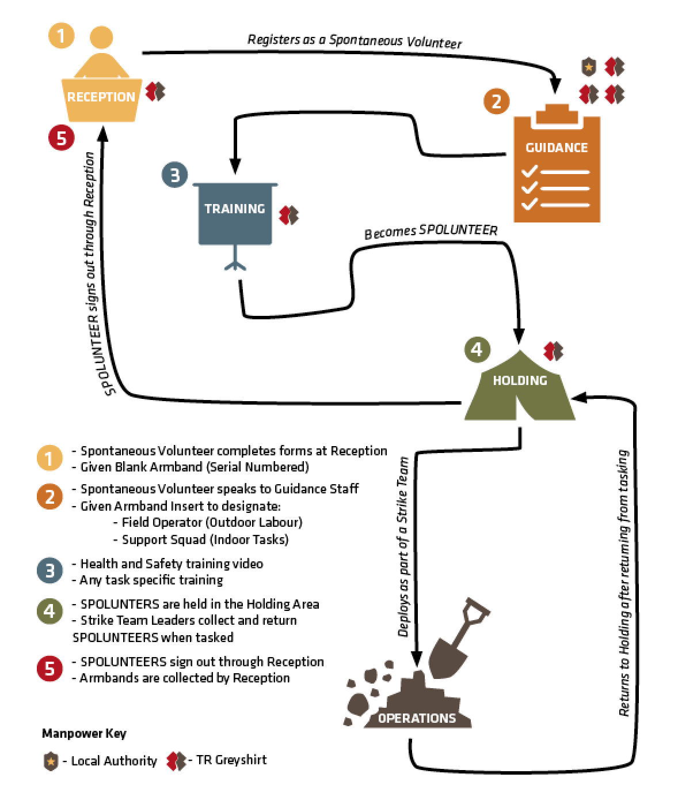
HOW HAVE WE IMPROVED THE PROCESS?
Sign up en route to or at venue
Collect arm band scanned linked to
QR code
Manager scans arm band and pulls up the skills listed by spolunteer to discuss and tick/reject in database
Training is completed via online videos as much as possible in reception
Manager queries which volunteers are free and each spolunteer’s QR code is scanned when they get assigned to a team
Spolunteers sign out by returning arm band and scanning the QR code. Spolunteer can indicate their future availability
Notes:
1. Spolunteers sign up to volunteer via a mobile friendly web application. On arrival they can be identified by their email address and assigned a unique spolunteer number by a unique QR code. The spolunteer number is stored in the database and is used to track the availibility of spolunteers throughout the day.
<number>

Slide 5
WHAT TECHNOLOGY HAVE WE USED?
Sign up is made via a mobile friendly website built using HTML, CSS and Bootstrap
Information is stored in a database built using mysql
QR codes generated with commonplace tools are scanned by staff via mobile app
Notes:
For each point say why that technology was used- how did it improve efficiency?
<number>

Slide 6
Website

Slide 7
Database
Created using mysql
Addresses requirements
Scalability
Security
Location track
Created two tables
Spolunteer information
Tracking information to be linked with QR code
Spolunteer Number | Workforce holding
159 (given by QR code) | Alpha
232

Slide 8
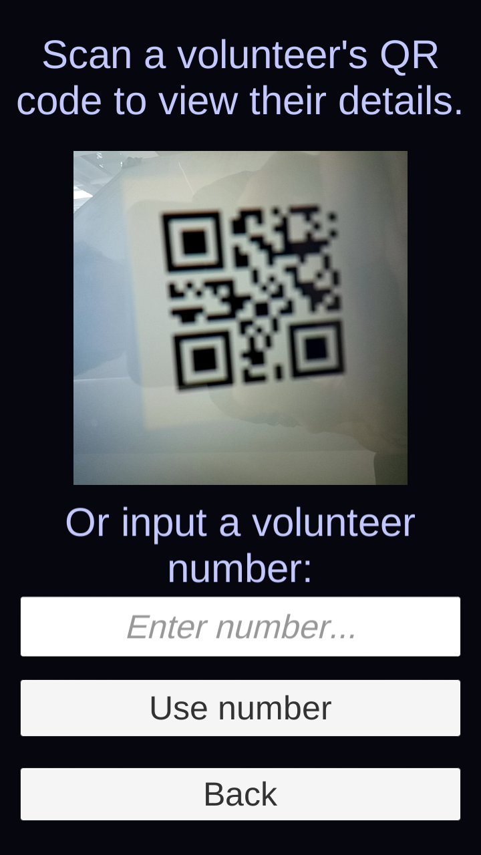
QR Code APP
Unity/C# app that can be deployed on any platform
Quickly assign roles to staff and keep track of spolunteer movement
Only relevant information visible to staff
Addresses requirements:
Speed
Simplicity

Slide 9
Summary AND QUESTIONS

